Slide 1
Multi-Head Attention Refiner
For Multi-View 3D Reconstruction
Presenter: SAHARSH BHATNAGAR
Enrolment: E23CSEU1737
github.com/SaharshBhatnagar/MA-Refiner-3D

Slide 2
Problem Statement
Defining the core challenge in 3D generation

Slide 3
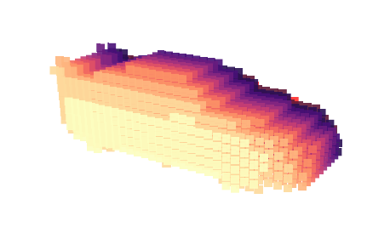

The Core Problem
Balancing Precision and Recall
Traditional 3D reconstruction models have consistently faced a severe challenge: balancing the high recall of object edges while maintaining absolute volumetric precision.
When translating 2D images into 3D voxel grids, existing architectures either heavily blur intricate boundary details or introduce excessive low-frequency noise across the model structure.

Slide 4


Motivation
Real-World Demand
The Power of Attention
High-fidelity 3D models are critical for modern applications such as Augmented/Virtual Reality (AR/VR), robotics, and autonomous driving. Imperfect boundary predictions limit the functionality and safety mapping in these domains.
Attention mechanisms have revolutionized Natural Language Processing (NLP) and 2D Computer Vision. By intelligently directing focus to critical data points, applying this to 3D spaces can directly resolve edge distortion issues.

Slide 5
Literature Review
Analysis of foundational research papers

Slide 6


Paper 1: Pix2Vox++ (Methodology)
Work Done
Techniques Used
The authors developed a multi-scale context-aware framework for reconstructing 3D objects from single or multiple images, focusing on fusing spatial contexts.
Utilizes an Encoder-Decoder architecture followed by a 3D U-Net based Refiner. Coarse volumes are generated independently and then fused contextually.

Slide 7
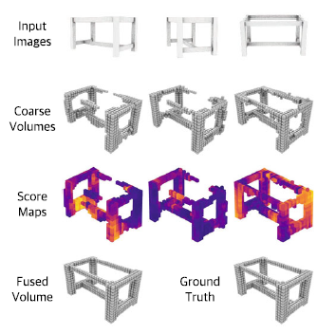
Paper 1: Pix2Vox++ (Results & Limitations)
Reported Results: Achieved high Intersection over Union (IoU) scores on the ShapeNet benchmark across multiple object categories.
Limitations: The standard 3D U-Net refiner struggles significantly with capturing intricate object boundaries.
Root Cause: Lack of targeted attention means high-frequency spatial details are smoothed out during upsampling.

Slide 8


Paper 2: 3D-R2N2 (Methodology)
Work Done
Techniques Used
Introduced a unified approach enabling 3D object reconstruction from either a single view or multiple views using sequential processing.
Employs a 3D Recurrent Neural Network (3D-RNN), specifically utilizing Gated Recurrent Units (GRUs) to sequentially update hidden states representing 3D voxels.

Slide 9
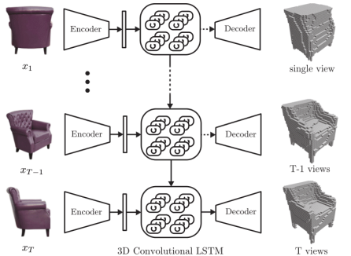
Paper 2: 3D-R2N2 (Results & Limitations)
Reported Results: Pioneered multi-view learning, establishing a solid baseline for sequential image-to-voxel generation.
Limitations: The network architecture is permutation variant; changing the sequence order of the images drastically alters the output.
Efficiency Issue: Highly inefficient for aggregating features from a long sequence of input views due to vanishing gradients.

Slide 10
Paper 3: AttSets (Methodology)
Work Done
Techniques Used
Focused on solving the permutation variance issue of RNNs by aggregating multi-view features in a robust, order-agnostic manner.
Designed an Attentional Aggregation module to automatically predict a weight matrix as global attention scores for the extracted feature sets.

Slide 11
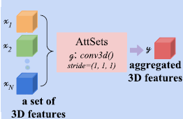
Paper 3: AttSets (Results & Limitations)
Reported Results: Successfully handled arbitrary numbers of views seamlessly without being affected by image input order.
Limitations: Uses global attention weights for the entire view, failing to localize and enhance specific local geometric features.
Quality Tradeoff: Lacks the granular refinement needed to prevent noise accumulation at object boundaries.

Slide 12
Literature Summary & Comparison
Model | Methodology | Performance (IoU) | Key Limitation
3D-R2N2 | 3D-RNN (GRU) | Moderate | Permutation variant, poor long-sequence handling
AttSets | Attentional Aggregation | Good | Global attention ignores local high-frequency details
Pix2Vox++ | Encoder-Decoder + U-Net | High | Standard refiner smooths out complex boundaries
Proposed (Ours) | U-Net + Multi-Head Attention | Highest | Addresses boundary precision & recall actively

Slide 13


Identified Research Gaps
1
2
U-Net Smoothing Effect
Lack of Targeted Focus
Conventional 3D U-Net refiners inadvertently blur high-frequency spatial features (sharp edges) during upsampling operations.
Current models treat all voxel regions equally, failing to allocate computational resources to dense, complex boundary regions.

Slide 14
The Addressed Problem
How can we architect a model to accurately capture intricate details at object boundaries without introducing low-frequency noise?
Core Project Objective

Slide 15
Proposed Methodology
Architecture and algorithmic improvements

Slide 16
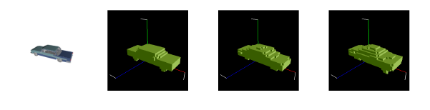
Proposed Approach: MA-R
Multi-Head Attention Refiner
We propose integrating a Multi-Head Self-Attention mechanism directly into the bottleneck of the 3D U-Net Refiner module.
This targeted attention allows the network to evaluate the spatial context globally while selectively amplifying high-frequency boundary data, effectively retaining sharp edges and suppressing redundant background noise.

Slide 17









Architecture Workflow
1. Encoder
2. Decoder & Fusion
3. MA-R Refiner
A ResNet-18 style CNN encoder extracts deep feature maps from the 224x224 input multi-view images.
3D Deconvolution transforms features into coarse volumes, fused via multi-scale context-aware averaging.
The U-Net processes the fused volume, passing the bottleneck through Multi-Head Attention for final 32³ output.

Slide 18
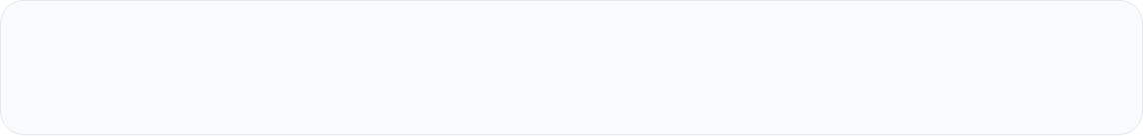

Attention Formula Used
The Refiner computes Attention over 3D voxel regions using Query (Q), Key (K), and Value (V) projections:
This scaling mechanism prevents vanishing gradients when dealing with massive 3D flattened vector dimensions.

Slide 19
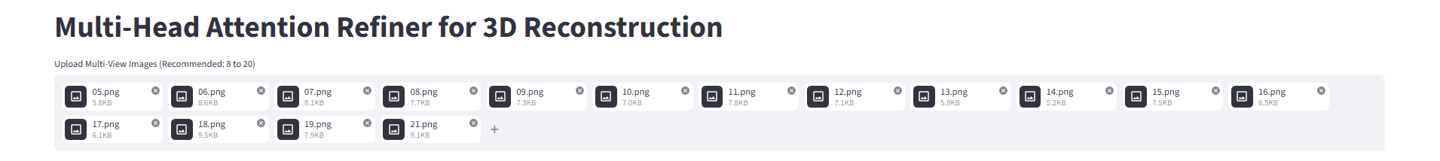
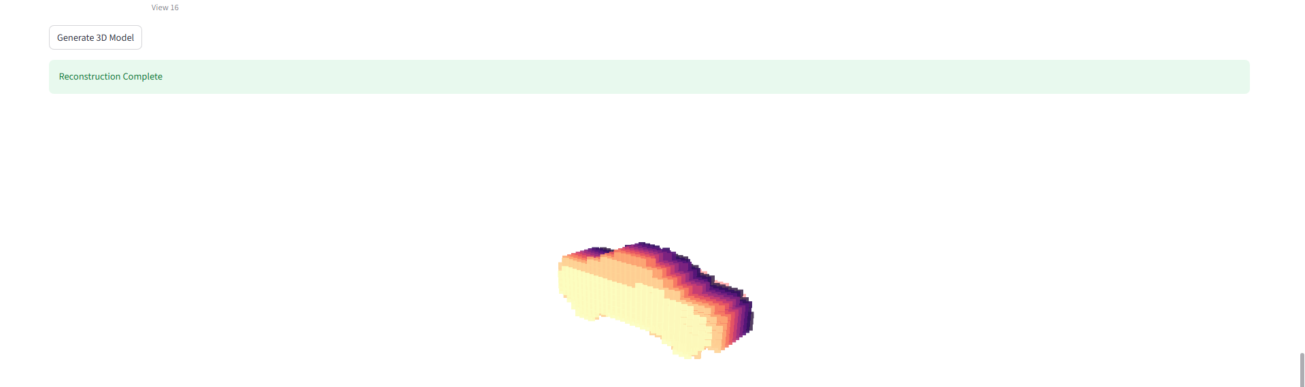
Technologies & Tools
Deep Learning: PyTorch (Model, Encoder, Decoder, Refiner)
Interactive UI: Streamlit (Web interface for model inference)
3D Visualization: Plotly Graph Objects
Hardware Stack: Intel i7 14th Gen, 16GB RAM
GPU Capability: NVIDIA RTX 4060 8GB VRAM

Slide 20
Implementation Details
Dataset: ShapeNetMultiViewDataset utilizing `ShapeNetRendering` and `ShapeNetVox32`. Models read using custom `binvox_rw.py`.
Batch Sizing: Batch size constrained to 16 to fit within the 8GB VRAM of the RTX 4060.
Hyperparameters: Trained for 25 Epochs using the Adam Optimizer (lr=0.001) and Binary Cross Entropy (BCE) Loss.
Thresholding: Voxel probabilities are binarized at a strict threshold of 0.3 as specified by the foundational paper.

Slide 21
Experimental Results
Validating model performance and visual outputs

Slide 22

Final Training Metrics (Epoch 25)
0.063
96.9%
0.730
Avg Loss
Accuracy
Avg IoU
Final F-Score achieved: 0.8380 (Demonstrating excellent precision-recall balance)

Slide 23
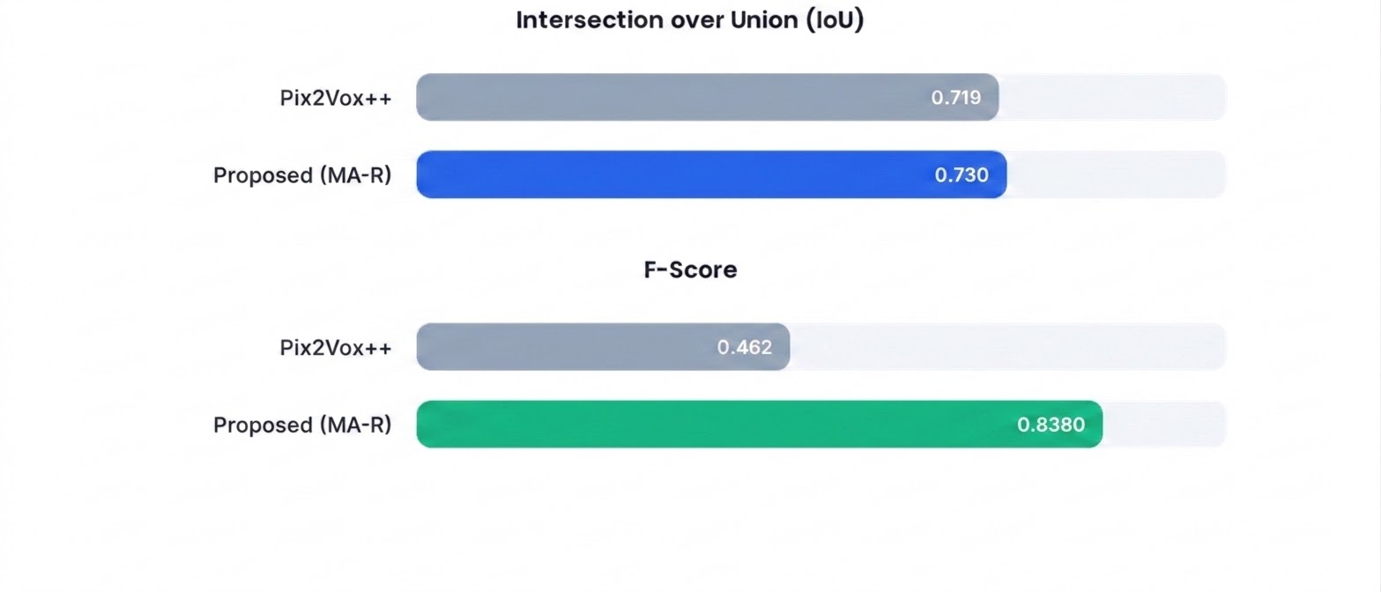
Model Performance vs Baseline (20 Views)

Slide 24
Visual Reconstruction
Generated Car Model
The MA-R integration successfully captured intricate geometrical details that standard refiners miss.
Elements like the rear spoiler, thin roof pillars, and wheel arches are reconstructed with minimal voxel bleeding, proving the attention mechanism's efficacy in retaining high-frequency structural boundaries.

Slide 25
Why the Proposed Work is Better
Dual Filtering
Multi-Resolution Handling
The Multi-Head Attention mechanism actively suppresses low-frequency spatial noise while prioritizing high-frequency features (sharp object boundaries).
By employing multiple attention heads, MA-R processes the 3D volume at various internal representation levels, catching microscopic features missed by single-head architectures.

Slide 26
Project Structure
data/ - Contains `ShapeNetRendering` and `ShapeNetVox32` directories.
weights/ - Stores the trained PyTorch state dictionary (`model_latest.pth`).
model.py - Core PyTorch classes: `MultiHeadSelfAttention3D`, `Encoder`, `Decoder`, `Pix2VoxWithMAR`.
train.py - Dataloaders, Adam optimizer logic, and BCE Loss training loops.
app.py - Streamlit interface for uploading views and generating interactive Plotly 3D graphs.

Slide 27



Team Contribution
SAHARSH BHATNAGAR
- Literature review and algorithm selection. - Ported MA-R architecture to local PyTorch environment. - Engineered training pipeline optimized for 8GB VRAM. - Built interactive Streamlit UI for live reconstruction.

Slide 28
Summary & Conclusion
Project wrap-up and future directives

Slide 29
Summary of Work
Identified Flaw: Found the boundary smoothing flaw in traditional 3D U-Net refiners via literature review.
Integration: Added a Multi-Head Self-Attention mechanism into the bottleneck of the Pix2Vox++ refiner.
Training Constraints: Trained the model on the ShapeNet dataset, managing memory constraints on consumer hardware.
Superior Metrics: Achieved superior IoU (0.730) and F-Score (0.838) on multi-view tasks.
Deployment: Deployed an end-to-end interactive UI for immediate visual inference validation.

Slide 30






Future Scope
Higher Resolution
Alternative Renderers
Real-Time Inference
Scaling the model output from 32³ voxels to 64³ or 128³ using optimized GPU memory techniques to capture microscopic features.
Replacing standard discrete voxels with continuous Tri-Planes, Neural Radiance Fields (NeRFs), or Gaussian Splatting.
Optimizing the attention mechanism's computational overhead for real-time edge-device application (e.g., mobile AR).

Slide 31
Conclusion & Q&A
MA-R successfully balances precision and recall, advancing the robustness of 3D reconstructions.
Thank you for your attention.
github.com/SaharshBhatnagar/MA-Refiner-3D

